Slide 1
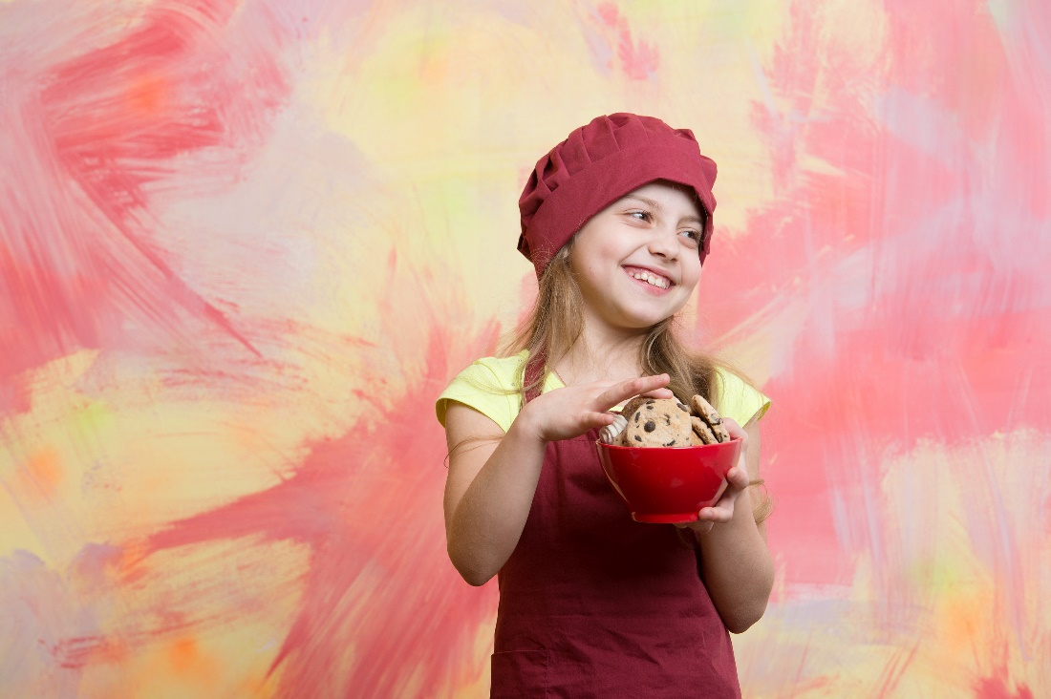
Exercise 3: Chocolate

Slide 2
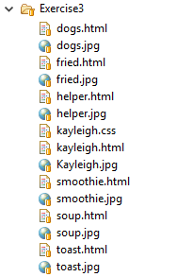
Exercise 3: Chocolate
https://github.com/topherCantrell/class-HTMLCSS/tree/master/Exercise3
Kayleigh has a knack for cooking with chocolate! Help her turn her recipes into an awesome web site.
Download the files for this exercise:
https://github.com/topherCantrell/class-HTMLCSS/tree/master/Exercise3
Organize the files into a clean structure
Find a good font for the site
Pick a color for the background
Use all your new HTML/CSS skills
Be creative and have fun!

